Slide 1

.NET Standard: One Library to Rule Them All
Carlos Matías Dieguez
Christian Echagüe
Software Architect
Project Manager
Tecnocode

Slide 3

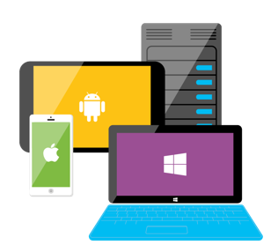







ASP.NET
Azure
Innovation
Open Source
Any app, any platform

Slide 4

C# is an elegant, type-safe, object-oriented, state of the art programming language that run on the .NET Framework
Run on 2.6 billion devices.
With C# and Visual Studio, you can share the same code on iOS, Android, Windows, Mac and more.
C#
Write C#. Create Apps, Webs, Games and Services for all major OS, like Windows, Linux, OSX

Slide 5



One Library to Rule Them All
.NET Framework
.NET Core
Xamarin
Application Models
WPF
ASP.NET 4.6
Win Forms
Universal Windows Apps 10.1
ASP.NET Core 2.0
Android 7.0
iOS 10.4
Mac 3.0
.NET Standard Library Based on .NET Standard
One Library to Rule Them All
Base Libraries
Base Class Library
CoreFX
Mono BCL
Common
Runtime Components
Compilers
NuGet packages
Next gen JIT (RyuJIT)
SIMD
Roslyn
.NET Compiler Platform
.NET Core 2.0 Libraries
.NET Framework 4.6 Libraries

Slide 6
.NET Standard 2.0
Introduces more APIs
Creates compatibility with .NET Framework libraries
Version | #APIs | Growth %
1.x | 13,501 | +1%
2.0 | 32,638 | +142%
XML
XLinq • XML Document • XPath • Schema • XSL
SERIALIZATION
BinaryFormatter • Data Contract • XML
DATA
Abstractions • Provider Model • DataSet
NETWORKING
Sockets • Http • Mail • WebSockets
IO
Files • Compression • MMF
THREADING
Threads • Thread Pool • Tasks
CORE
Primitives • Collections • Reflection • Interop • Linq

Slide 7
Multi-targeting and multiple runtimes
Compile for targets frameworks
.NET Core applications netcoreapp2.0
.NET Standard Libraries netstandard2.0
.NET Full Framework net46
More frameworks and TFMs
Linux
CentOS 7.1+
Debian 8.2+
Fedora 23
Linux Mint 17.1, 18
OpenSUSE 13.2, 42.1
Oracle Linux 7.1
Ubuntu 14.04 & 16.04
Mac OS X 10.11, 10.12
Windows
Windows Nano Server TP5
Windows Server 2016
Red Hat Enterprise Linux 7.2
Windows 7+ / Server 2012 R2+
Windows Server Core
Xamarin iOS 10.14
Xamarin Android 7.5

Slide 8

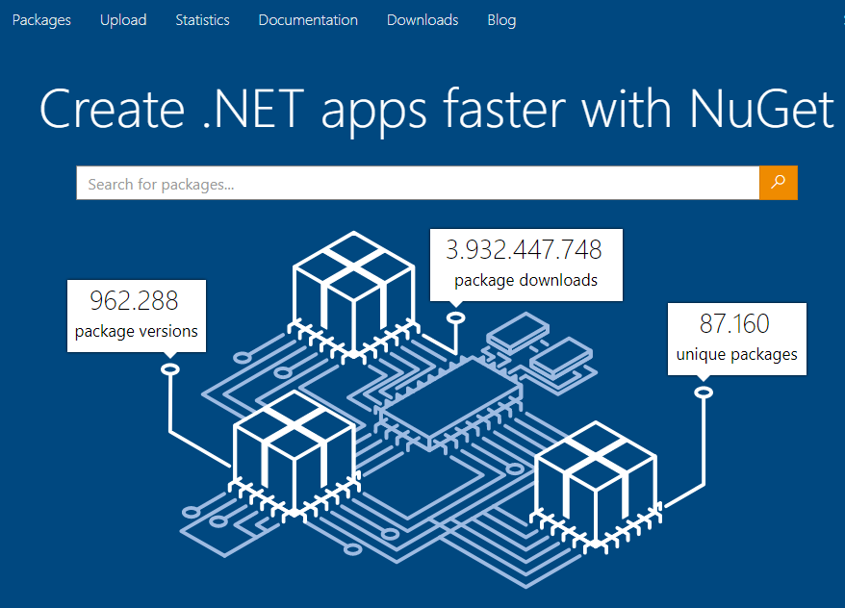

NuGet is the package manager for .NET. The NuGet client tools provide the ability to produce and consume packages. The NuGet Gallery is the central package repository used by all package authors and consumers.

Slide 9
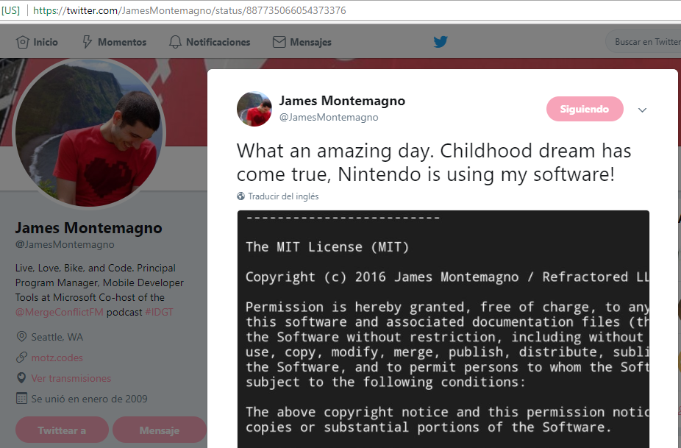
Reaching all with .NET Standard & NuGet

Slide 10
Hands on Lab I
https://github.com/matiasdieguez/netstandard-workshop/blob/master/docs/lab-1.md
En este Lab repasamos los primeros pasos para trabajar con GitHub, una plataforma de desarrollo colaborativo para alojar proyectos utilizando el sistema de control de versiones Git.

Slide 11
Hands on Lab II
https://github.com/matiasdieguez/netstandard-workshop/blob/master/docs/lab-2.md
En este Lab utilizaremos el nuevo repo creado en el Lab I para hostear un proyecto de biblioteca .NET Standard que implemente un cliente tipado para la API que cada coder elija.

Slide 12
Hands on Lab III
https://github.com/matiasdieguez/netstandard-workshop/blob/master/docs/lab-3.md
En este Lab crearemos proyectos en distintas plataformas .NET para implementar nuestros paquetes .NET Standard.

Slide 13
Hands on Lab IV
https://github.com/matiasdieguez/netstandard-workshop/blob/master/docs/lab-4.md
En este Lab dotaremos a nuestro proyecto de Integración Continua utilizando AppVeyor.

Slide 14
Thank you!
Carlos Matías Dieguez
Christian Echagüe
matias.dieguez@tecnocode.net
christian.echague@tecnocode.net
@dieguezrojo
@echaguechris
www.tecnocode.net

